Slide 1
Stock Market Price Prediction
Data Analysis & Machine Learning Using Python Training
Team Name : Team Brute Force
Team Members :
Srajit Srivastava
Vishal Maurya

Slide 2

What if the company falls and I lose my money ???
Should I invest in Hindustan Unilever ???

Slide 3

Outline:
Goal of the Project
Dataset Description
Data Pre Processing
Data Visualization
Machine Learning Model
GUI Using Tkinter

Slide 4

GOAL OF THE PROJECT
This project proposes a method to predict stock market price for a trending day.
It is an attempt to determine whether the analysis of previous index of market can efficiently help in the calculation of closing market index of a trading day.

Slide 5
Dataset Description
Dataset is taken from Yahoo Finance.
The dataset consists of stocks of Tata Motors of approx. 10 years.
The attributes of dataset are as follows:
Date - Corresponding Date for stock values.
Open - Opening price of a stock on a particular day.
High - Highest selling stock value for a day.
Low - The lowest value of the selling price of a stock on a given day.
Close - Contains closing value of a stock on a given day.
Volume - The number of shares traded or brought on a given day.
Adj Close - The closing price of a stock after paying dividends to the investors.

Slide 6
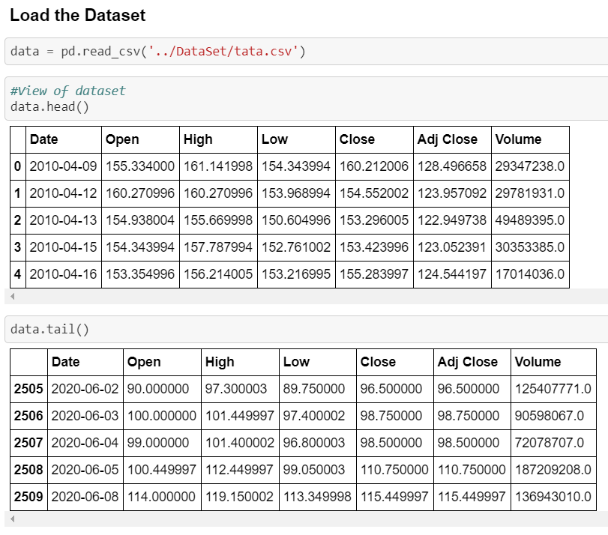
Dataset Pre Processing
Loading the data for pre processing

Slide 7
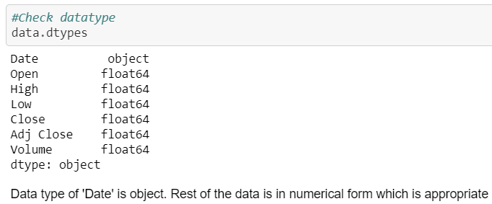
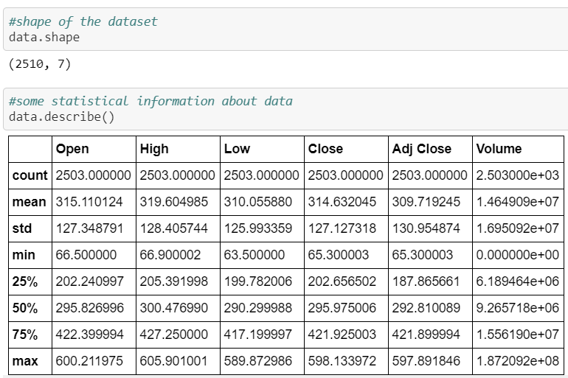
Dataset Information
Date is of object type and rest of the attributes are of numerical type.
Statistical Description of dataset.

Slide 8
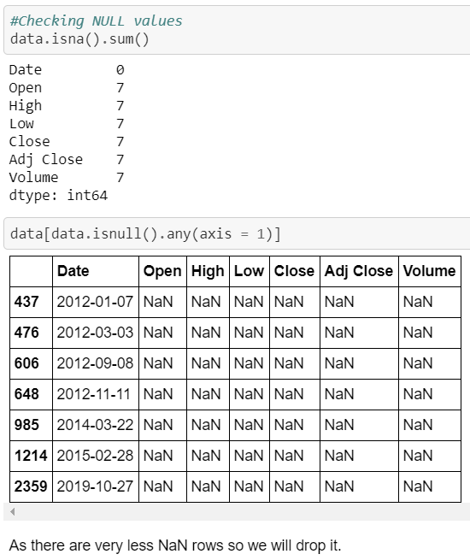
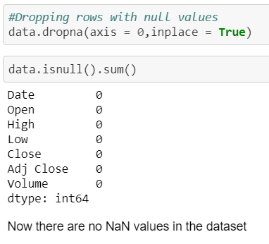
Dataset Cleaning
Removing rows having NaN values.

Slide 9
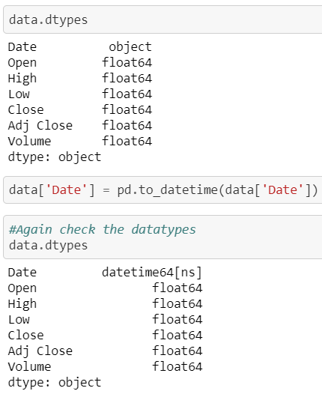
Data Type Compatibility
Date is of object type. To make it compatible we convert it to ‘DateTime’ format.

Slide 10
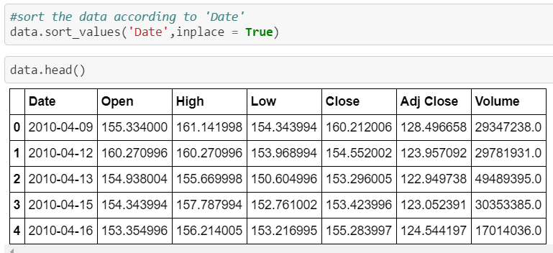
Sorting Dataset
Dataset is sorted according to the date of stock exchange.

Slide 11
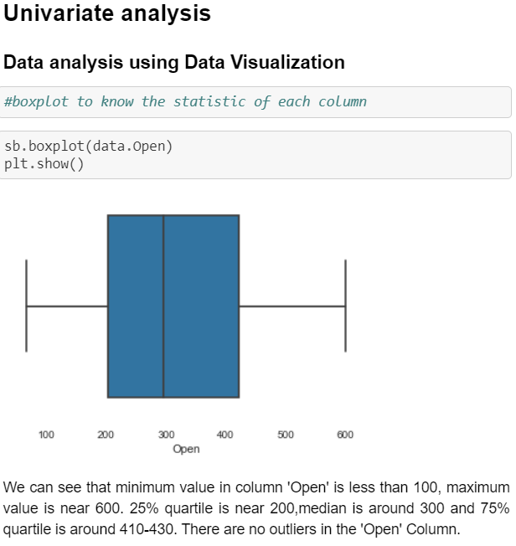
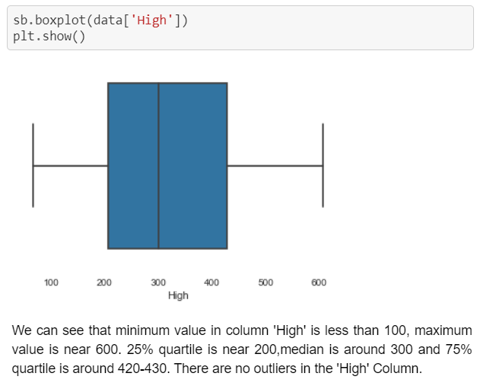
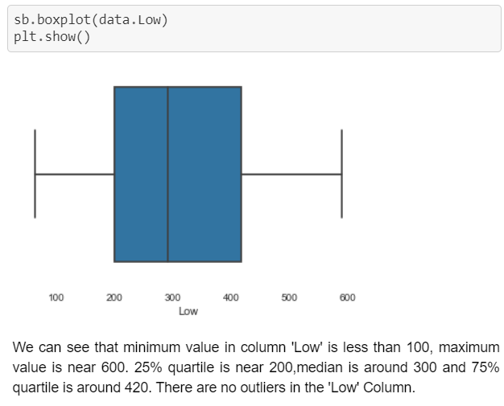
Data Visualization
Univariate Analysis using Boxplot

Slide 12
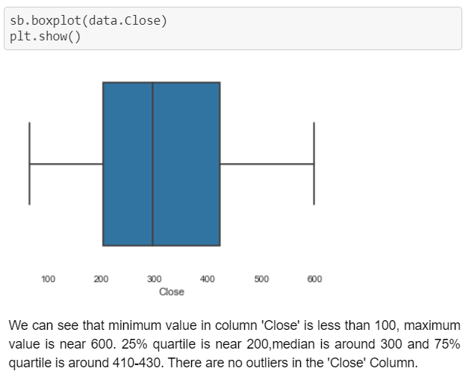
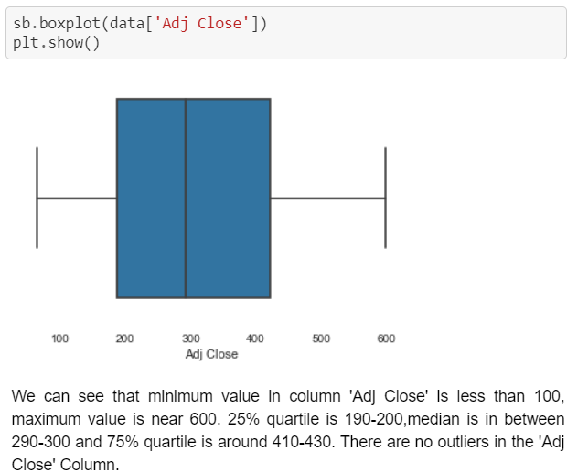
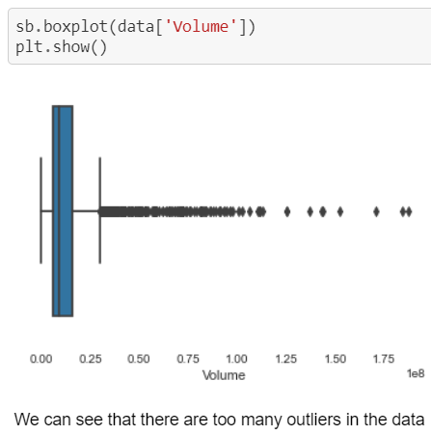
Box Plot of Attributes

Slide 13
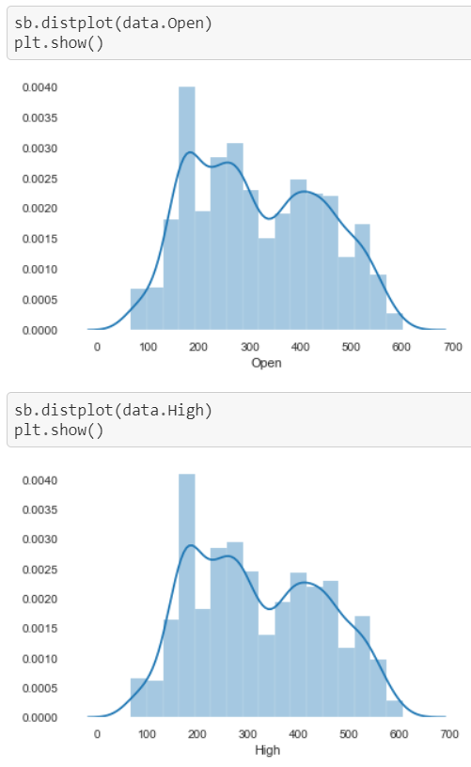
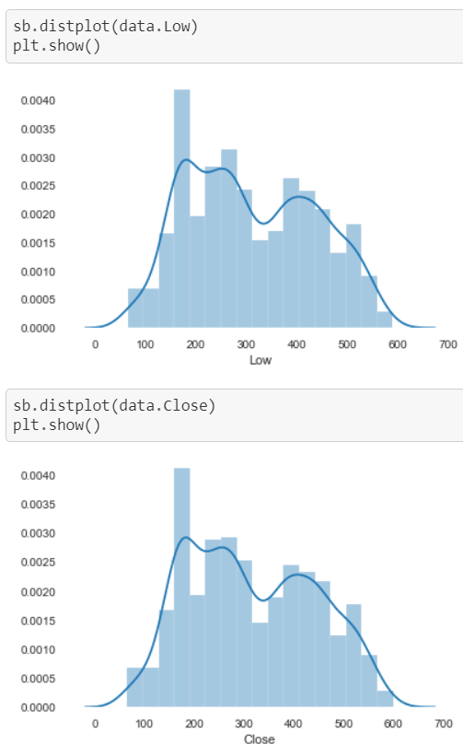
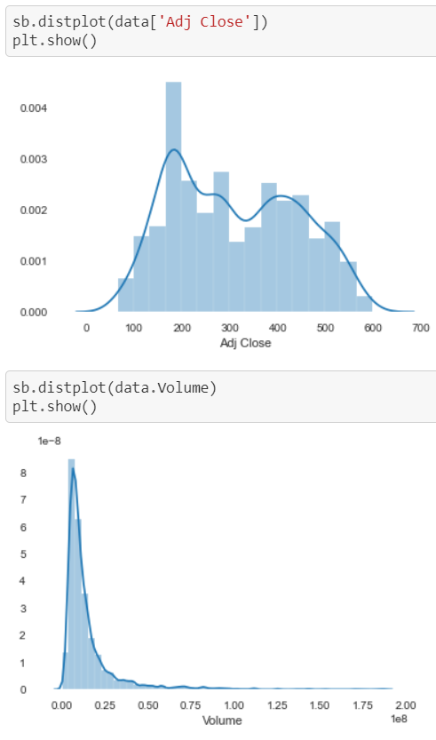
Dataset Distribution Analysis Using Distplot

Slide 14
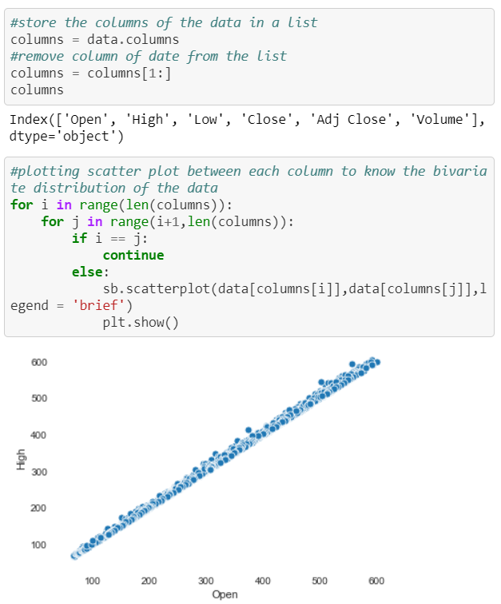
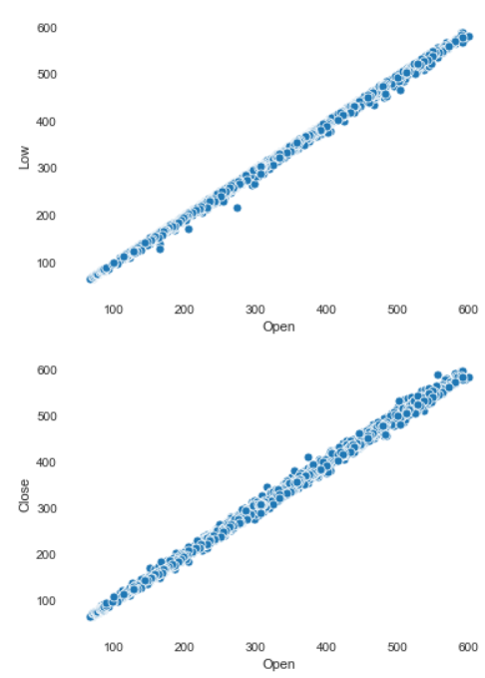
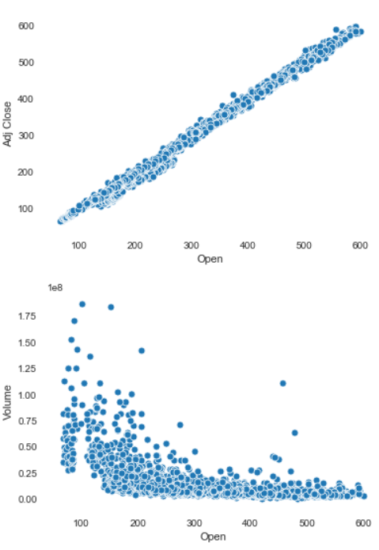
Bivariate Analysis Using Scatterplot

Slide 15
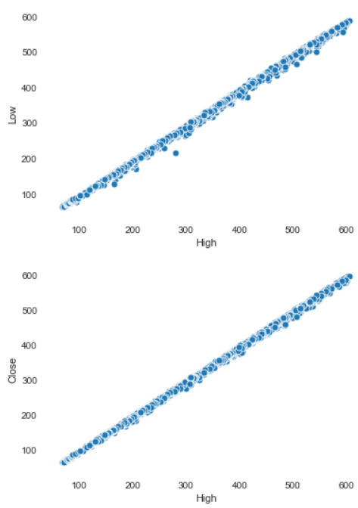
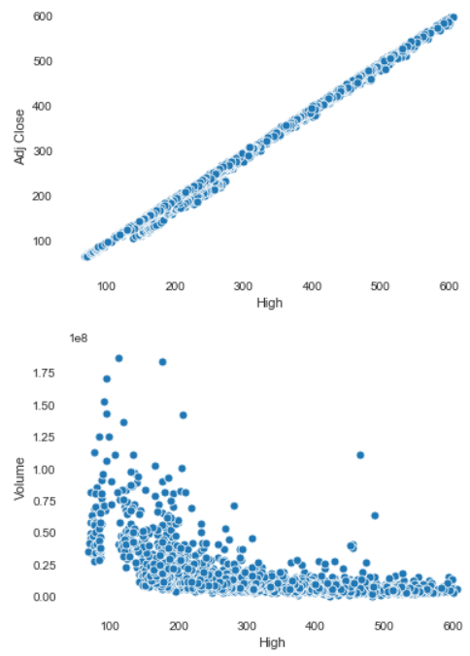
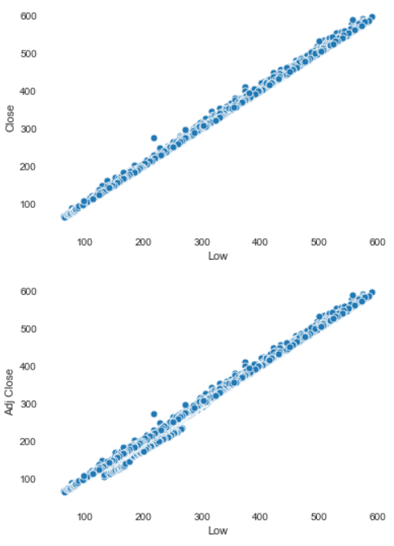

Slide 16
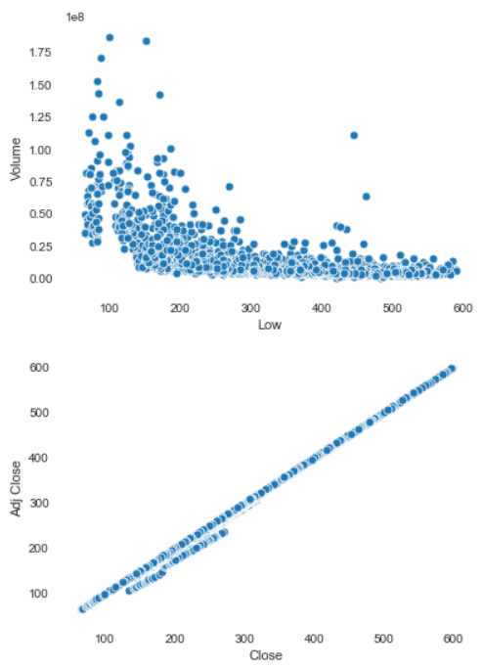
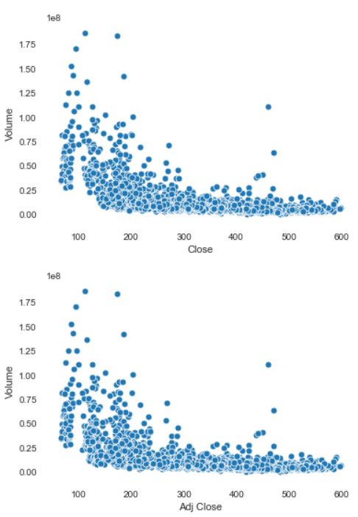

Slide 17
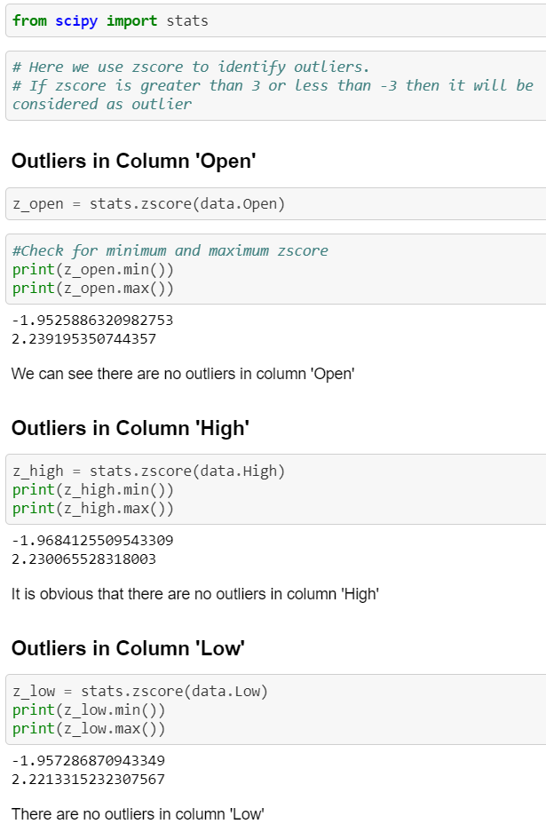
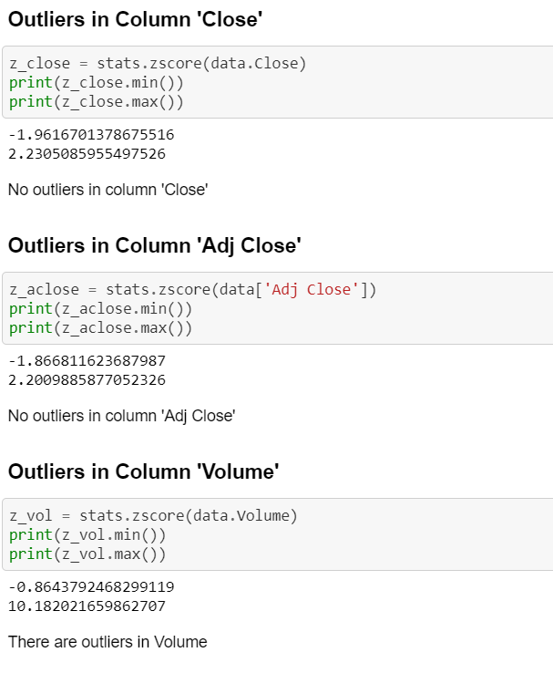
Identifying Outliers

Slide 18
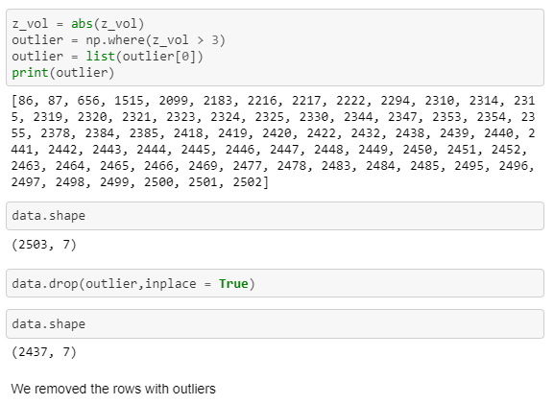
Removing Outliers

Slide 19
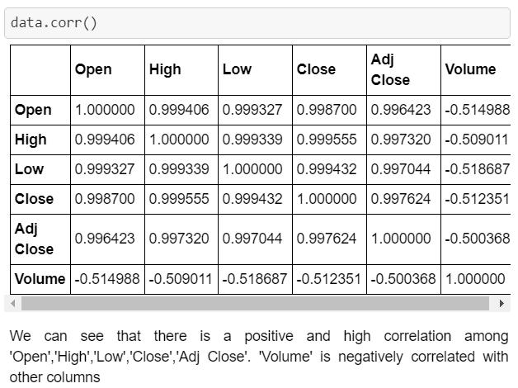
Correlation Matrix

Slide 20
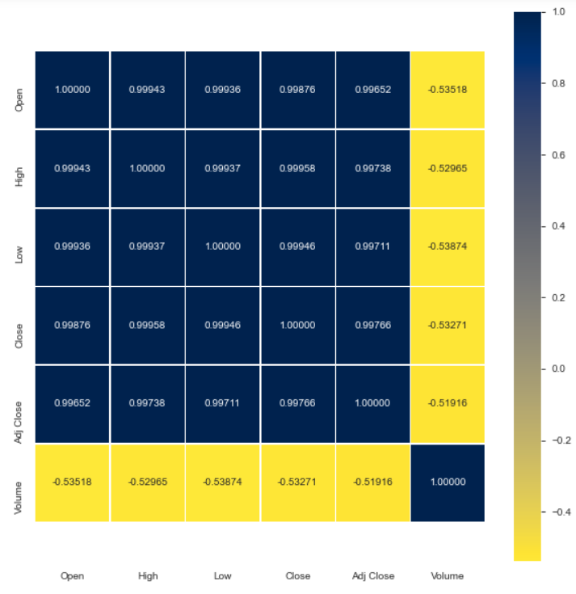
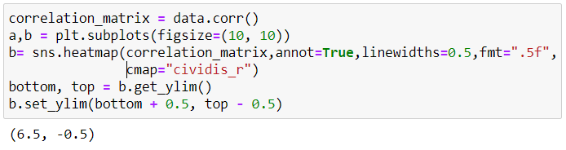
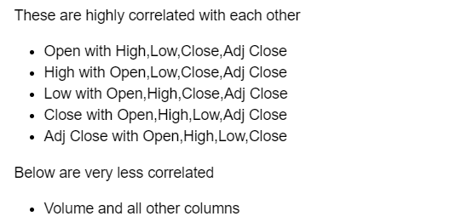
HeatMap

Slide 21
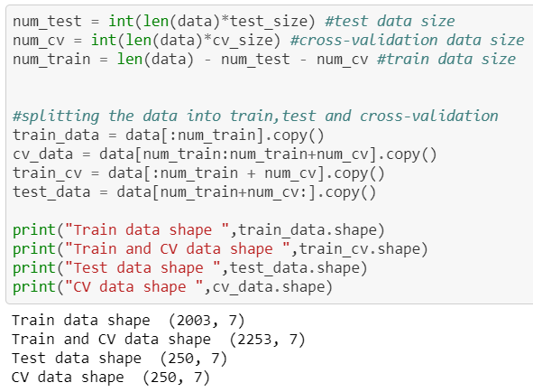
Machine Learning Dataset Spliting

Slide 22
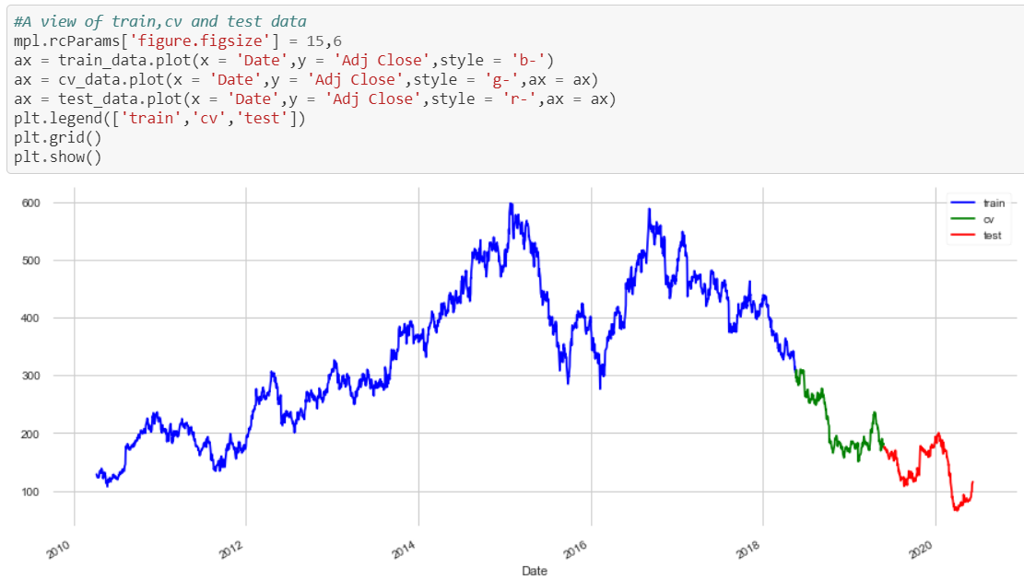
Graphical Representation

Slide 23
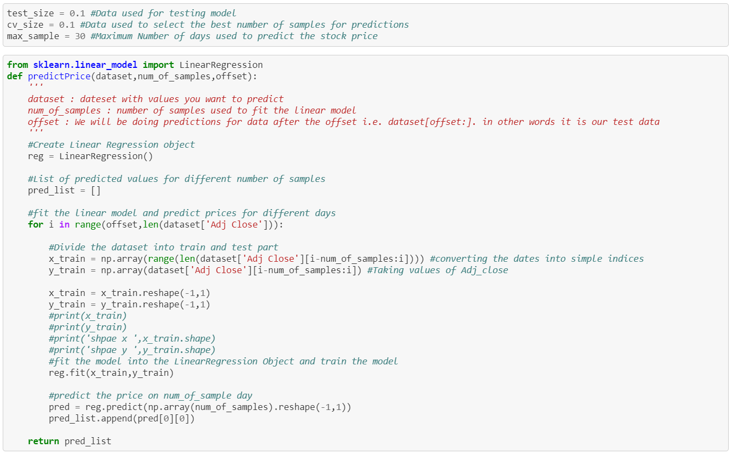
Machine Learning Model
Function to do prediction with the given number of samples

Slide 24
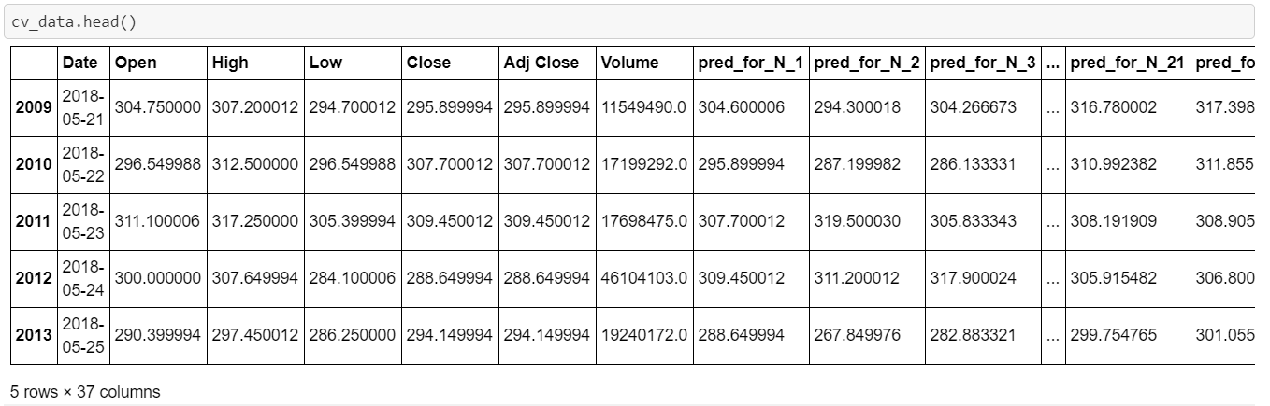
Prediction Analysis
Above given table shows the attributes of the cross validation data and attributes showing the predicted value of the stock on a particular date and N is the number of days used for predictions.

Slide 25
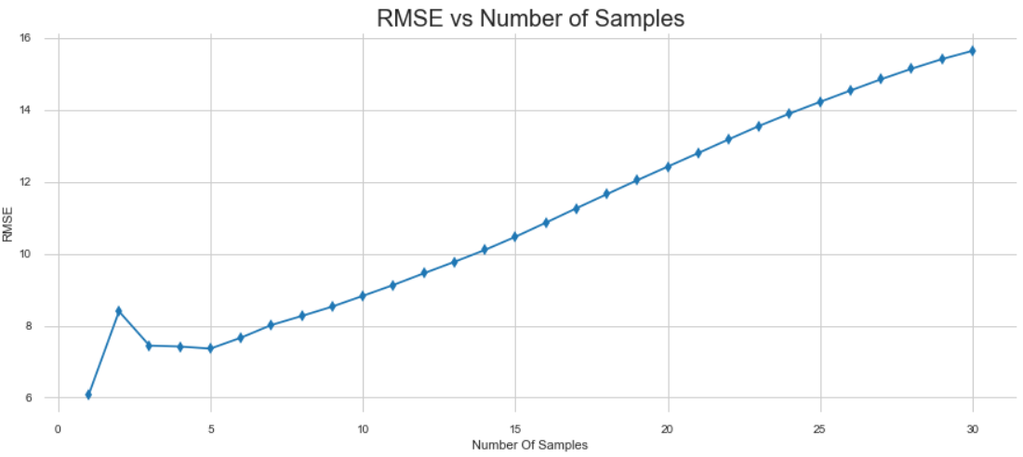
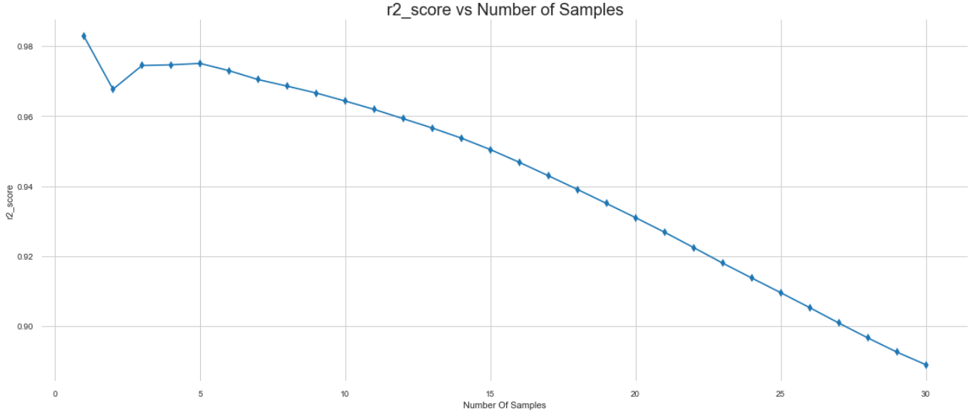
Analyzing Accuracy of the Model Using Visualization
RMSE vs Number of Samples
R2_score vs Number of Samples

Slide 26
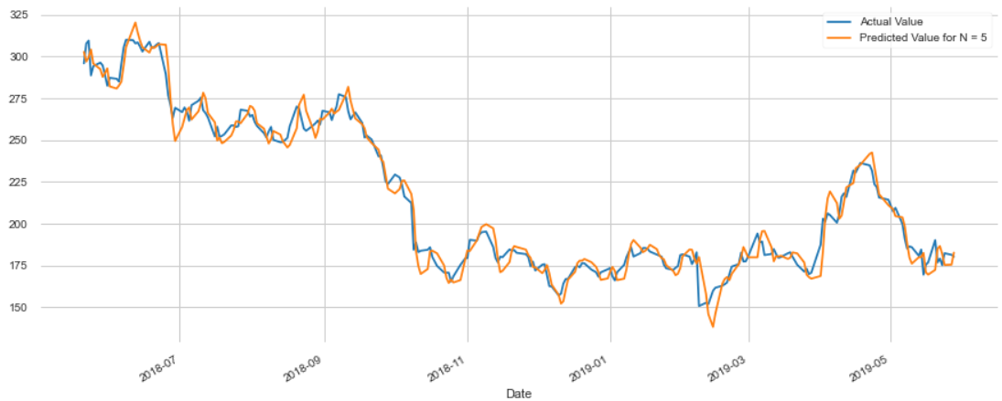
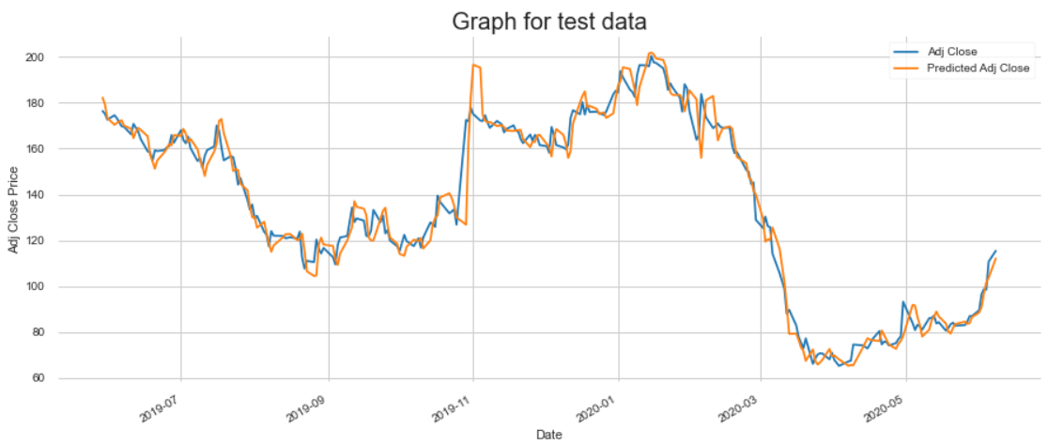
Cross Validation Dataset
Test Dataset

Slide 27
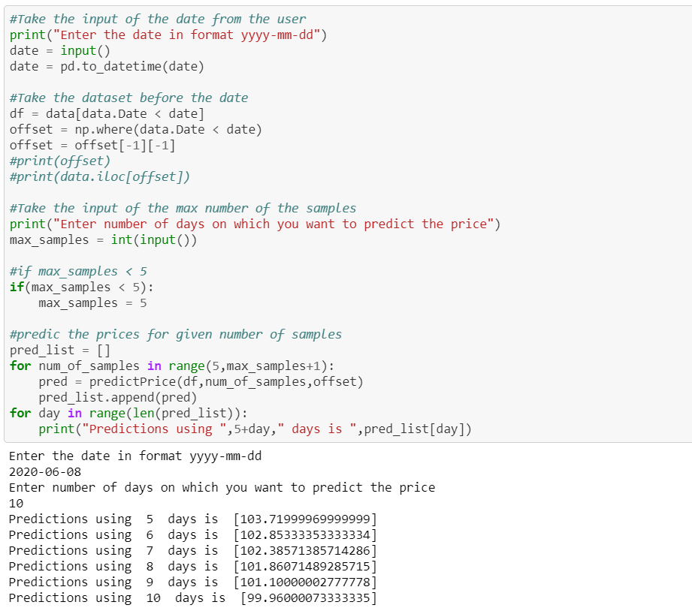
Prediction using Input data from user

Slide 28
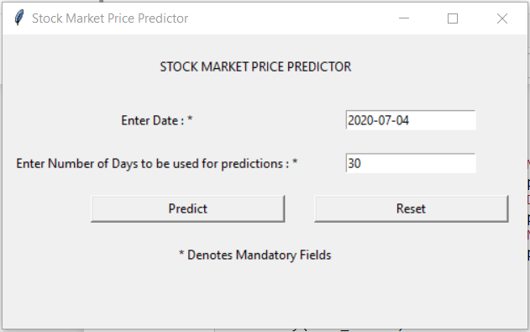
GUI Using Tkinter
User Input Window Having all required functionalities

Slide 29
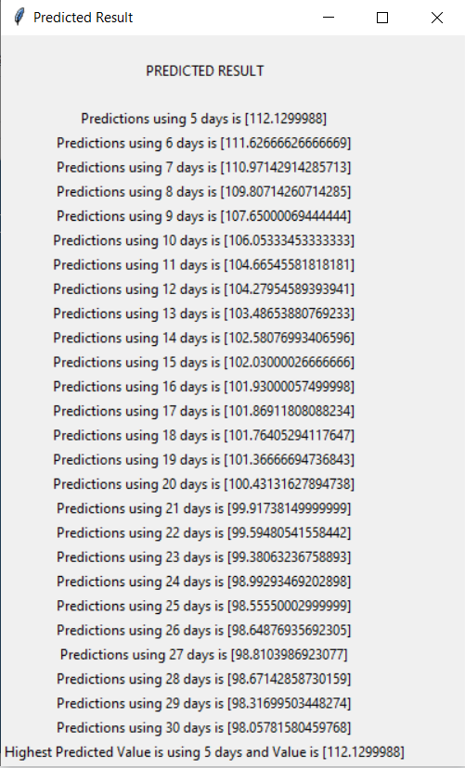
Predicted Result Using GUI

Slide 30
Thank You!

